Slide 1


Slide 2
Highwall Mining

Slide 3
Highwall Mining
Presentation outline
Highwall mining systems
Geotechnical issues & rating
Guidance Control
Failures and causes
Conclusions

Slide 4
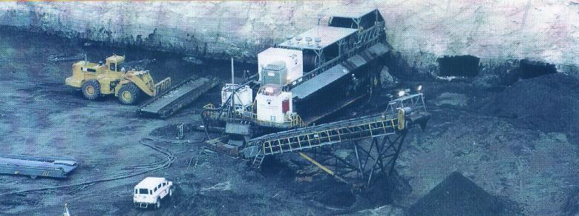
Highwall Mining
Highwall Mining
Driving parallel roadways into highwall/ coal seam using remote controlled mining machinery – 200 - 500 m depth

Slide 5
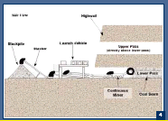
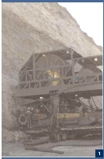
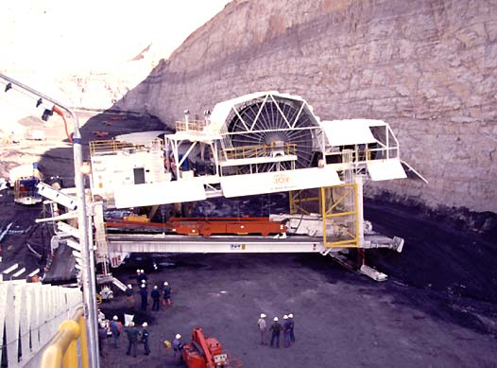
Highwall Mining
Highwall Mining System (1)
Addington Highwall Mining system
Addcar system

Slide 6
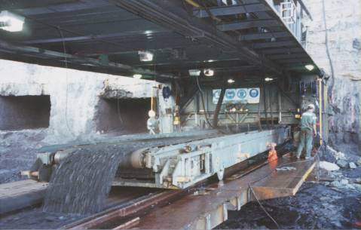
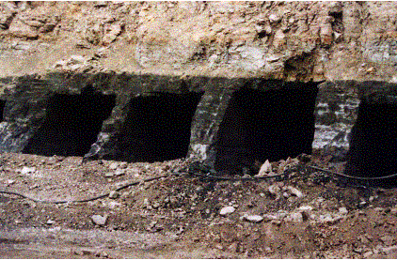
Highwall Mining
Highwall Mining Systems (1) cont.
Addcar System
  Launch vehicle
  Conveyor cars

Slide 7
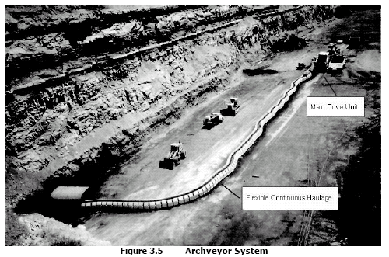
Highwall Mining
Highwall Mining Systems (2)
Archveyor system

Slide 8
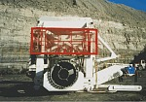
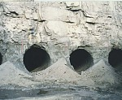
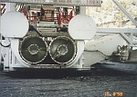
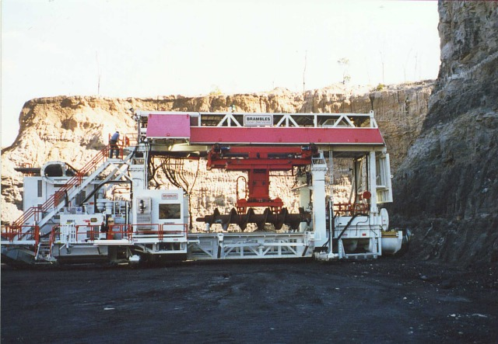

Highwall Mining
Highwall Mining Systems (3)
Auger system

Slide 9
Highwall Mining
Geotechnical Issues & Rating
  Unsupported span stability
  Pillar stability
  Panel Stability
  Case studies
  Design guidelines

Slide 10
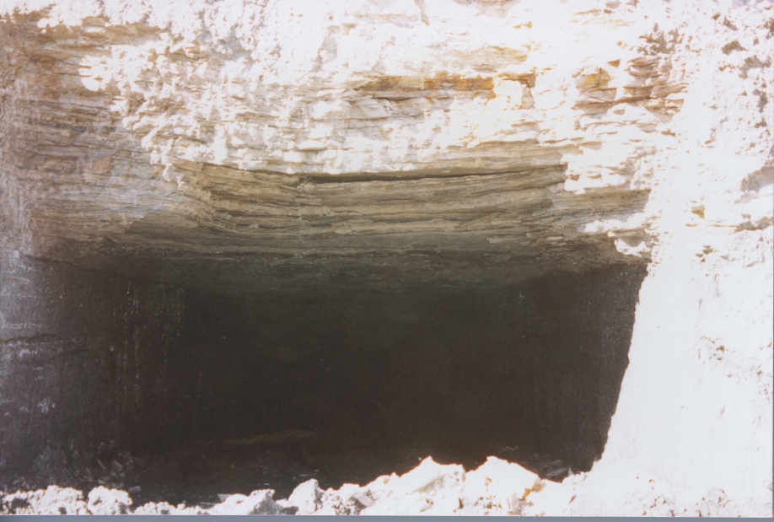
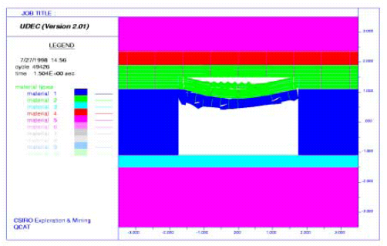
Highwall Mining
Unsupported Span Stability
  Typical failure mechanism – delamination & snap-through
  Simple analytical – thickness of roof plate, Y,
  Probabilistic approach
  Realistic prediction – Geology, rock properties

Slide 11
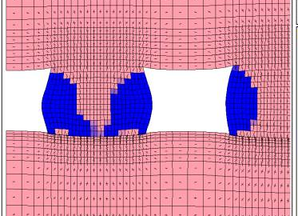
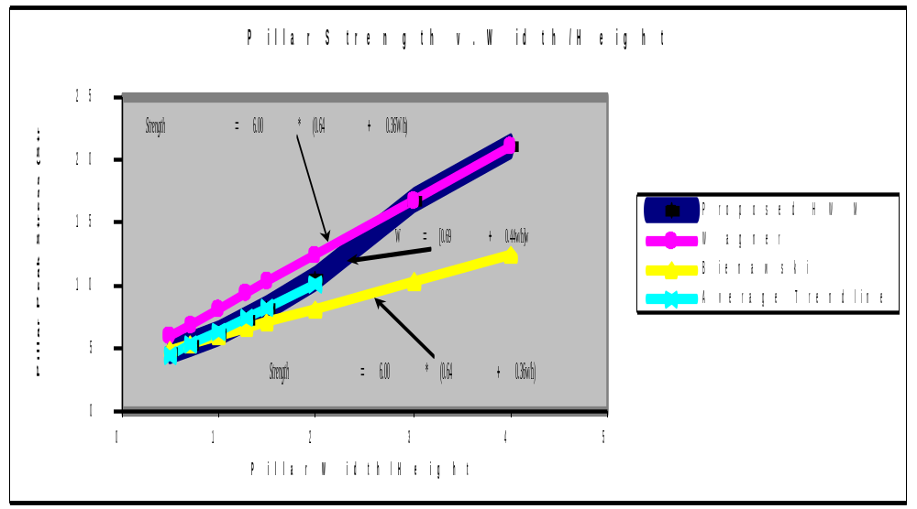
Highwall Mining
Pillar Stability
  Lab testing of coal strength
  Empirical approach
  Pillar stability modelling
  Applications and verification in field

Slide 12
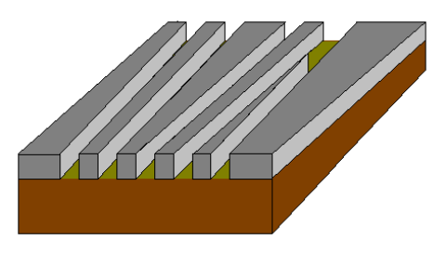
Highwall Mining
Panel Stability
  Panel stability depends on local mine stiffness
  Panel factor of safety
  One pillar failure may lead to total panel failure
  Roadways to be driven in perfect parallel

Slide 13
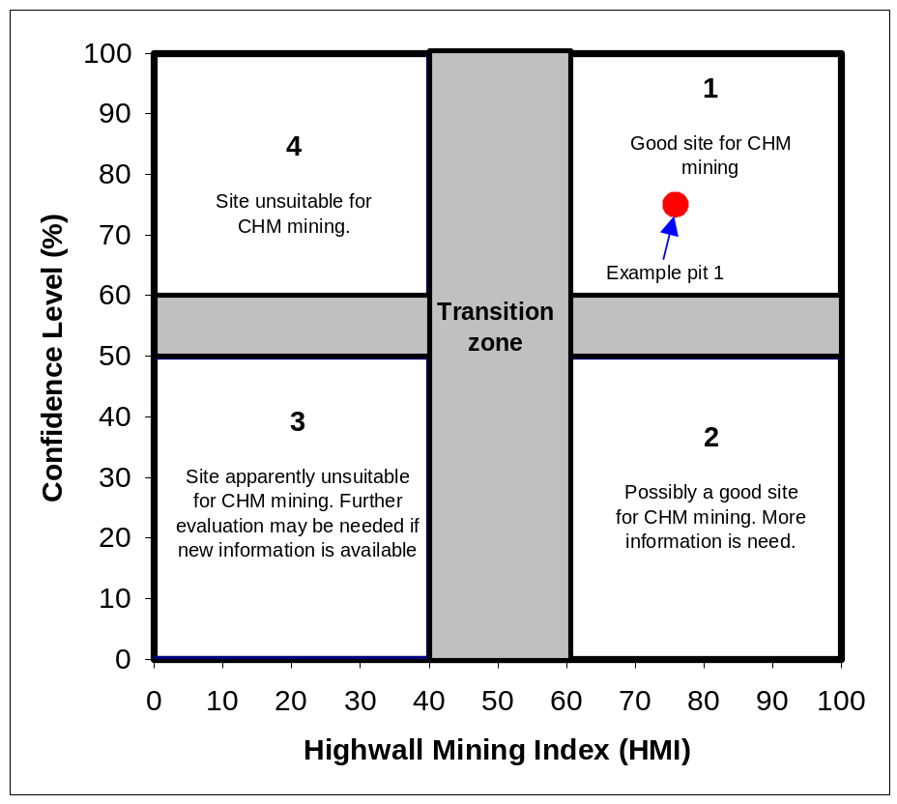
Design Guidelines
Highwall Mining
Highwall Mining Index (HMI) has been developed
15 key factors are considered, e.g. roof condition; mine reserve etc.;
Key factors are weighted differently in HMI;
Uncertainty on judgement is incorporated.
A given site has two index values: HMI rating, confidence level.
Recommendation is given for any HMI/Confidence ratings.

Slide 14
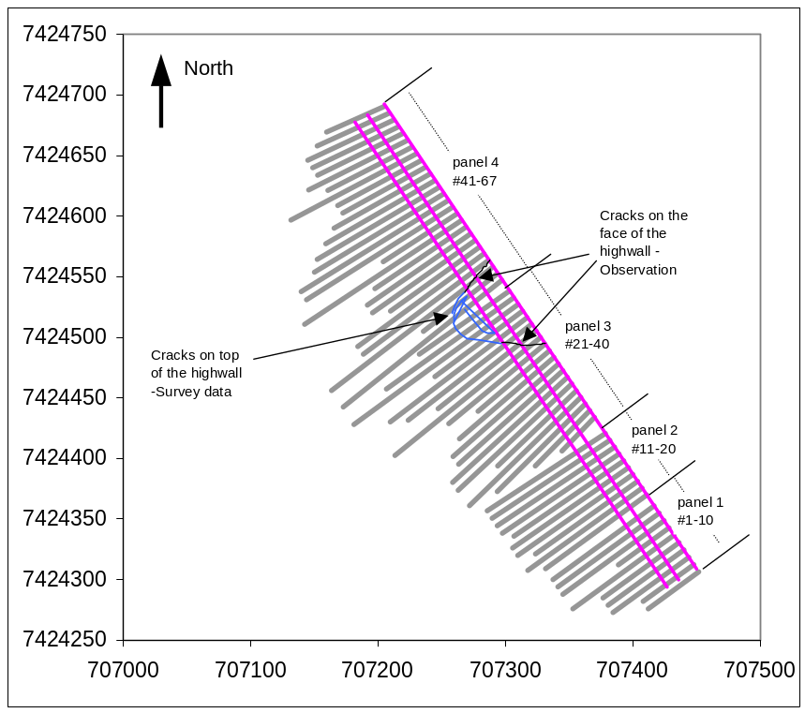
Highwall Mining
Guidance Control (1)
Driving parallel roadways
  remote miner
  200 to 500 m depth
Problems
  Cut-through’s connection
  Pillar failure - frequent roof falls
  Limited penetration depth

Slide 15
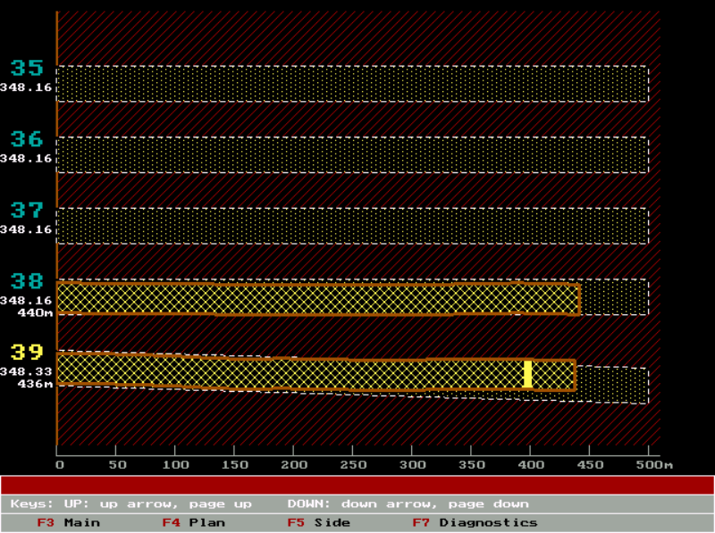
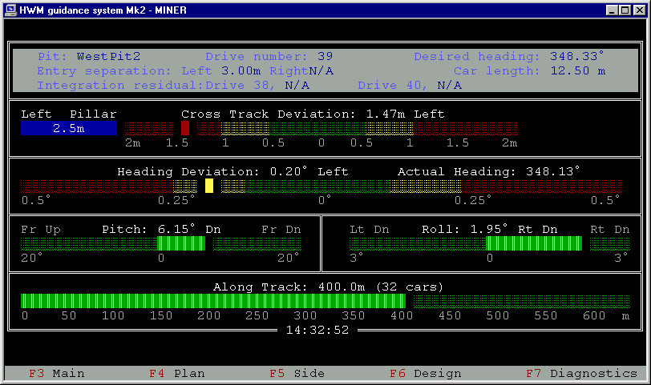
Guidance Control (2)
Highwall Mining
Problems to solve
  Uncertainty in pillar size
  Frequent cut-throughs
  Reduced penetration depth
  pillar/panel failure
Guidance system
  Military grade Inertial Navigation System
  Independent odometer
  Controlling computers
  Operator displace and interface
Achievements
  Used in every HWM system in Australia
  No mining equipment lost due to collapse
  Penetration depths increased - 350m to 510m

Slide 16
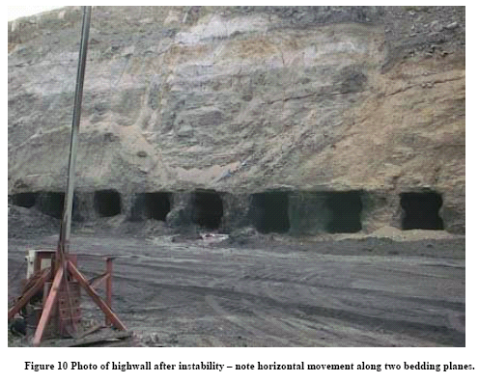
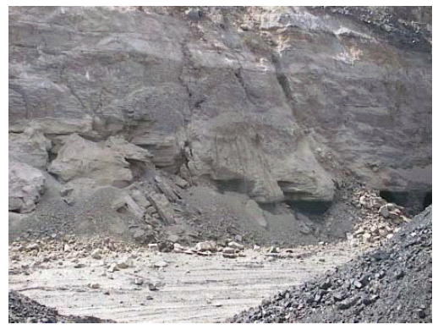
Highwall Mining
Failures (1)
Panel failure
Before
After

Slide 17
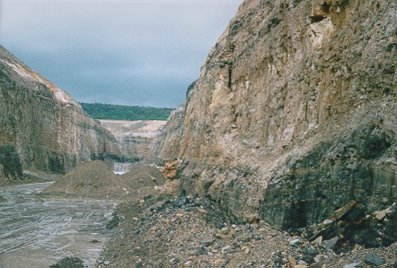
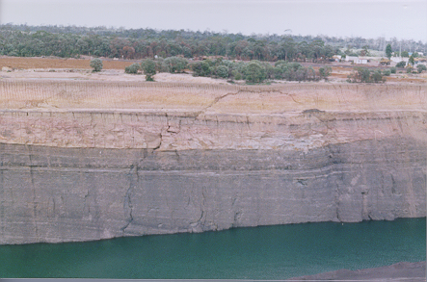
Highwall Mining
Failures (2)
Panel failure
Panel failure at Ulan Mine
Local panel failure at Yarrabee Mine

Slide 18
Highwall Mining
Factors contributing to pillar/panel failures
Lack of site investigation
Poor knowledge on span stability
Inadequate pillar design
Poor guidance control
Critical panel width
Lack of knowledge on insitu stresses
No monitoring and feedback

Slide 19
Highwall Mining
Production
Production ~ 1 million tonnes per year
Employees – 50 (High productivity – main advantage)
Continuous inert gas injection @ 150 l/s
Penetration depth – varies – 100 to 500 m (Av 300m)
  Gas issues
  Stability issues
Each roadway driven – almost in one day (or less)
Production share in Australia – 1%

Slide 20
Highwall Mining
Conclusions
Main attraction – high productivity and low cost
Suitable for certain conditions – 500 m boundary
May lead to more fires and collapses
Around 50% of extraction
Creates problems for deeper reserves
Production share in Australia – 1%
Punch longwall – preferred for large reserves
  High production and longer term view

